Slide 1
Name:- Yash Rajendra Gaikwad
Data Analytics Trainee
Project 6:- Bank Loan Case Study.
Software Used:- Microsoft Excel.
Analysis done on following Points:-
A) Identify Missing Data and Deal with it Appropriately:- As a data analyst, you come across missing dat in the loan application dataset. it is essential to handle missing data effectively to ensure the accuracy of the analysis.
Task:- Identify missing data in the dataset and decide on an appropriate method to deal with it usong excel built-in function and features.
B) Identify Outliners in the Dataset:- Outliners can significantly impact the analysis and distort the results. you need to identify outliner in the loan application dataset.
Task:- Detect and identift outliners in the dataset using Excel statistical function and features, focusing on numberical variables.
C) Analyze Data Imbalance:- Data imbalance can affect the accuracy of the analysis, especially for binary classification problems.
Task:- Determine if there is data imbalance in dataset and calculate ratio of data imbalance using Excel function.

Slide 2
D) Perform Univarite, Segmented Univariate and Bivariate Analysis:- To gain insight into the driving factors of loan default, it is important to conduct various analysis on cousumer and loan attributes.
Task:- Perform univariate analysis to understand the distribution of individual variables, segmented univariate analysis to compare variabledistributions for different scenarios, and bivariate analysis to explore relationship between variables and the target variable using Excel Functions and features.
E) Identify Top Correlations for Differenr Scenarios:- Understanding the correlation between variables and the target variable can provide insights into stromg indicators ofloan default.
Task:- Segment the dataset based on different Scenarious. and identify the top correlations for each segmented data using Excel Functions.
MICROSOFT EXCEL FILE:- https://docs.google.com/spreadsheets/d/1tgmGcpx9cmGHbVpD6r4QAubecG-PgD_q/edit?usp=drive_link&ouid=103974361659264463652&rtpof=true&sd=true
VIDEO LINK:-https://www.loom.com/share/71722adfb0424bb59daa57fcc3e03340?sid=0dbcd61a-5f08-4723-b32b-2e9e41d52d1a

Slide 3
A) Identify Missing Data and Deal with it Appropriately:- As a data analyst, you come across missing dat in the loan application dataset. it is essential to handle missing data effectively to ensure the accuracy of the analysis.
Task:- Identify missing data in the dataset and decide on an appropriate method to deal with it usong excel built-in function and features.
Process:-
First to count the blank values in column we use COUNTBLANK formula and find the blank value for the all columns.
After that we calculate the percentage of blank value for every column. we simpally devide the blank value from the total number of values in the column. also convert that value into Percentage from the home tab.
First, we drop the column which have more then 40% blank values.
In column NAME_TYPE_SUIT we fill the missing values with “Unaccompained”.
Also in column OCCUPATION_TYPE we fill the missing values with “Unknown”.
For the columns with numbers we fill it with the Median value of the column.
We use the Column chart for visualization for both chart.

Slide 4
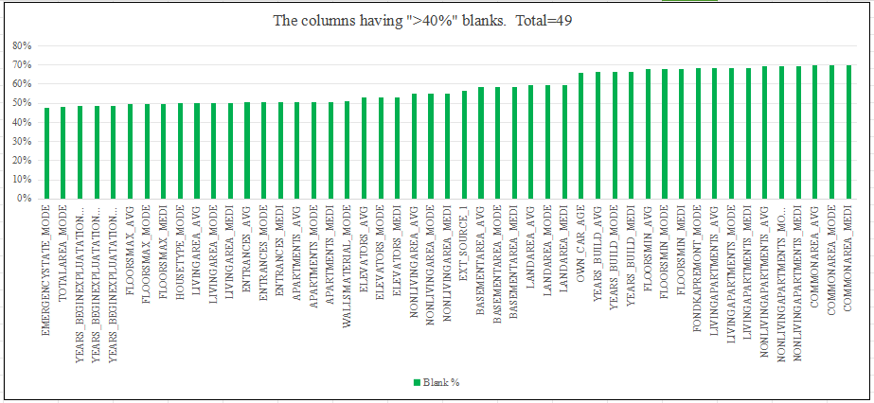
The columns having More then 40% of blank:- There are total 49 columns which have more then 40% of blank values. * We drop the columns which have more then 40% blanks

Slide 5
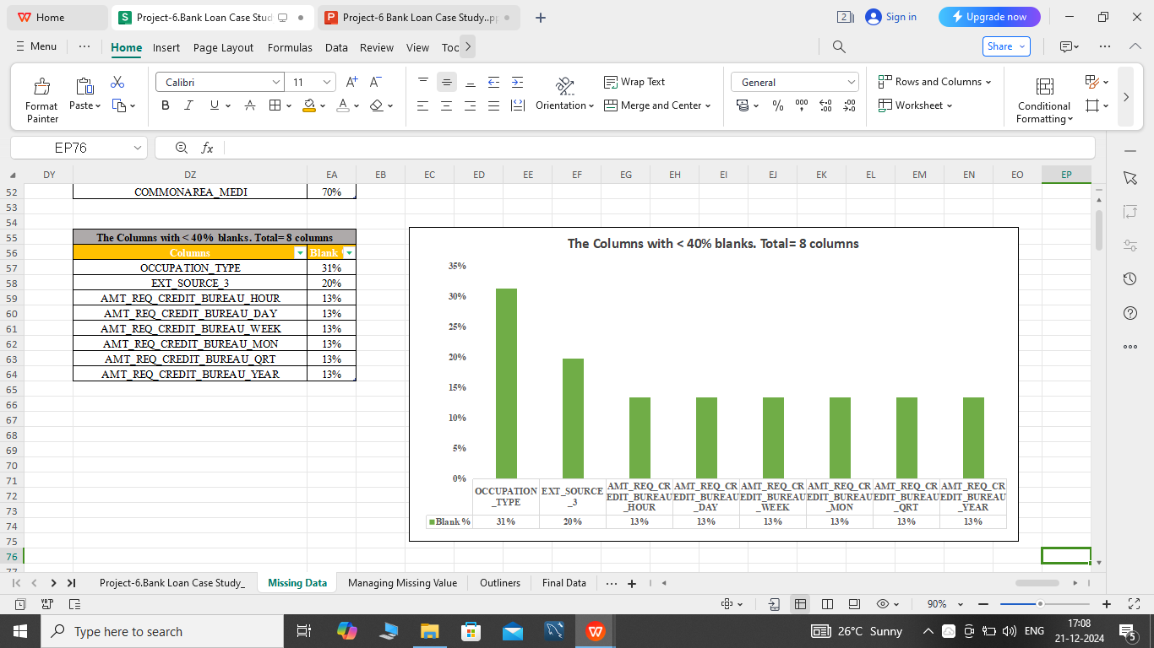
The columns having less then 40% blanks:- There are total 8 columns which have less then 40% of blank values.

Slide 6
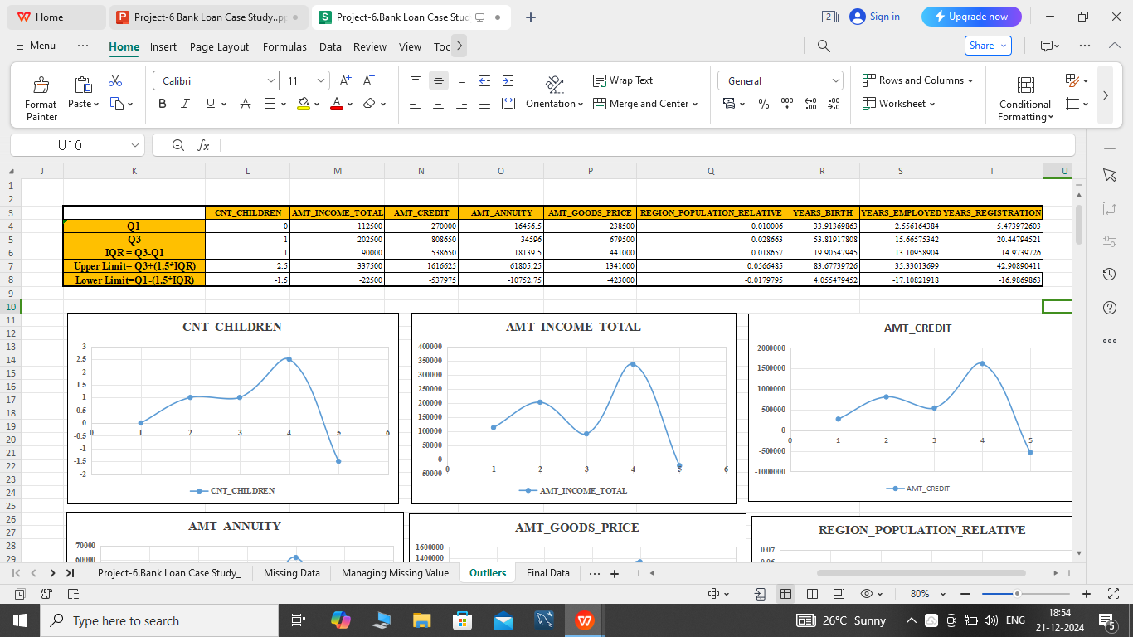
B) Identify Outliners in the Dataset:- Outliners can significantly impact the analysis and distort the results. you need to identify outliner in the loan application dataset.
Task:- Detect and identift outliners in the dataset using Excel statistical function and features, focusing on numberical variables.
Process:-
First we take data on another sheet, then we use the QUARTILE formula for the 1st quart and call it Q1.
After that we use QUARTILE formula for 3rd quart and call it Q2.
After that we find Inter Quartial Range (IQR). IQR=Q3-Q1
Lastly we find the Upper Limit and Lower limit.
UPPER LIMIT= Q3+(1.5*IQR) LOWER LIMIT=Q1-(1.5*IQR)
We use the Scatter Plot chart for Visualization.

Slide 7
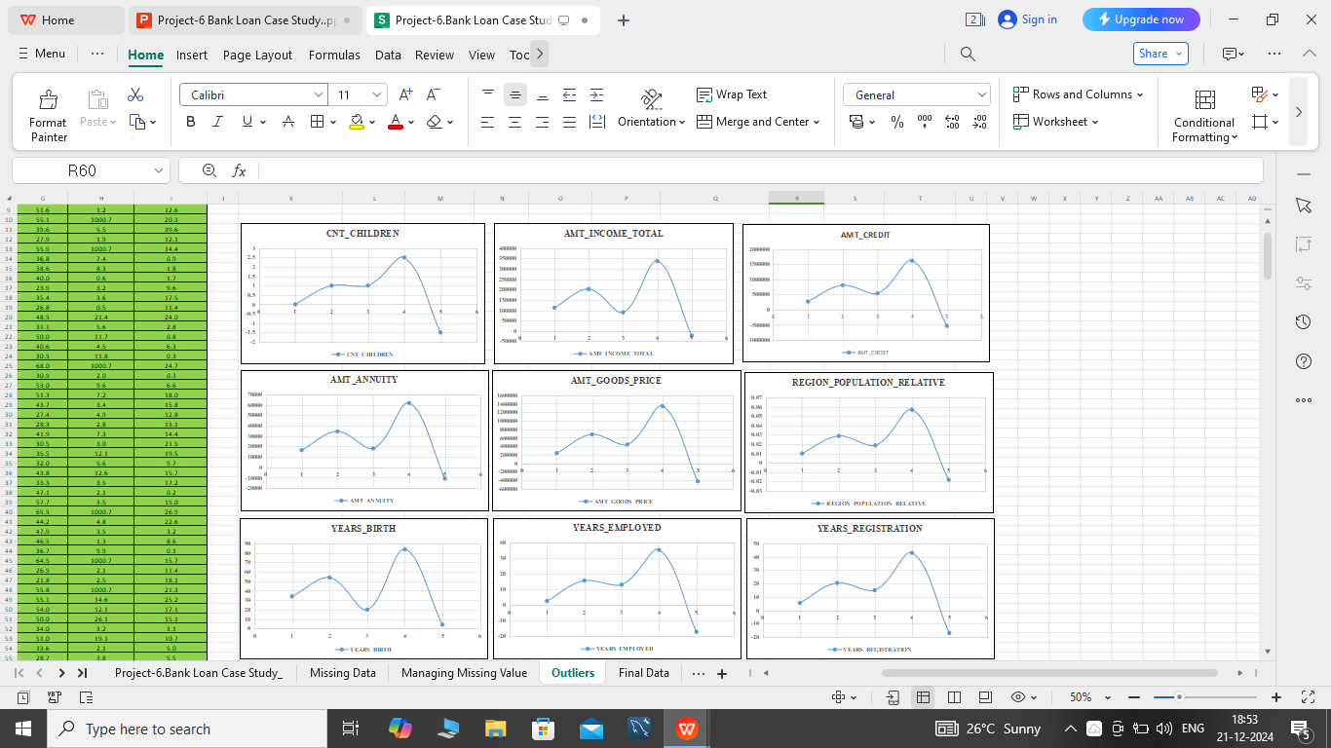

Slide 8
C) Analyze Data Imbalance:- Data imbalance can affect the accuracy of the analysis, especially for binary classification problems.
Task:- Determine if there is data imbalance in dataset and calculate ratio of data imbalance using Excel function.
Process:-
For finding data imbalance we use the Target column. so, we copy column to another sheet.
We use the COUNTIFS formula to find the Defaulter and Non-Defaulter.
In target collume 0 indicates Non-Defaulters customers and 1 indicate Defaulter customers.
We can also use Pivot table. placing Target in Rows and the Count of Target into Values.
Now, we find the maximum and minimum value in count of target colume by using MAX and MIN formula.
After that we devide the MIN by MAX and we will get the Ration of Imbalance.
Lastly we use the Pie Chart to visulization of chart.

Slide 9
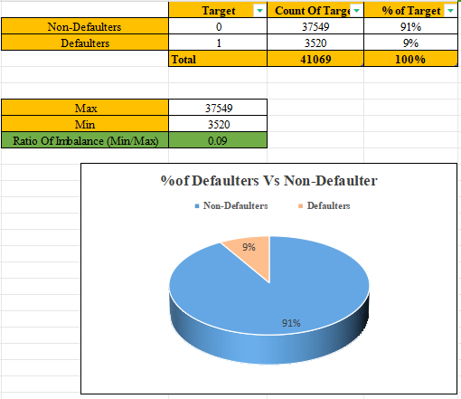
Result:- The Ratio Of Imbalance is 0.09.

Slide 10
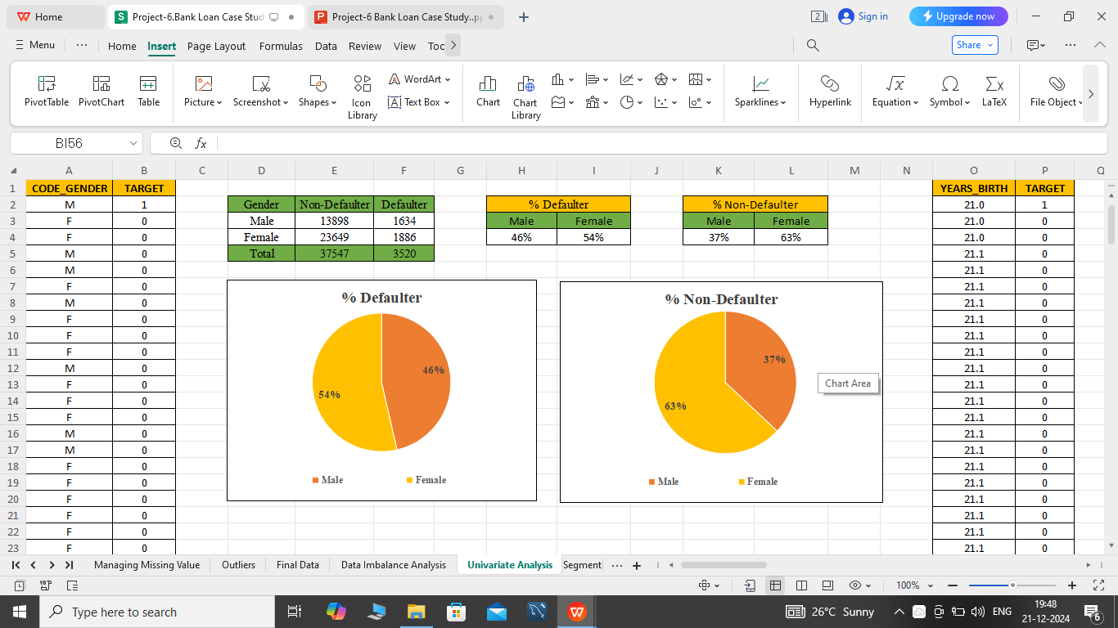
D) Perform Univarite, Segmented Univariate and Bivariate Analysis:- To gain insight into the driving factors of loan default, it is important to conduct various analysis on cousumer and loan attributes.
Task:- Perform univariate analysis to understand the distribution of individual variables, segmented univariate analysis to compare variabledistributions for different scenarios, and bivariate analysis to explore relationship between variables and the target variable using Excel Functions and features.
Process:-
Univarite Analysis:-
1) Gender Analysis:- *The more number of Females taken lone then the Males but % Defaulters in female is more.
*Male have less % of Defaulters.

Slide 11
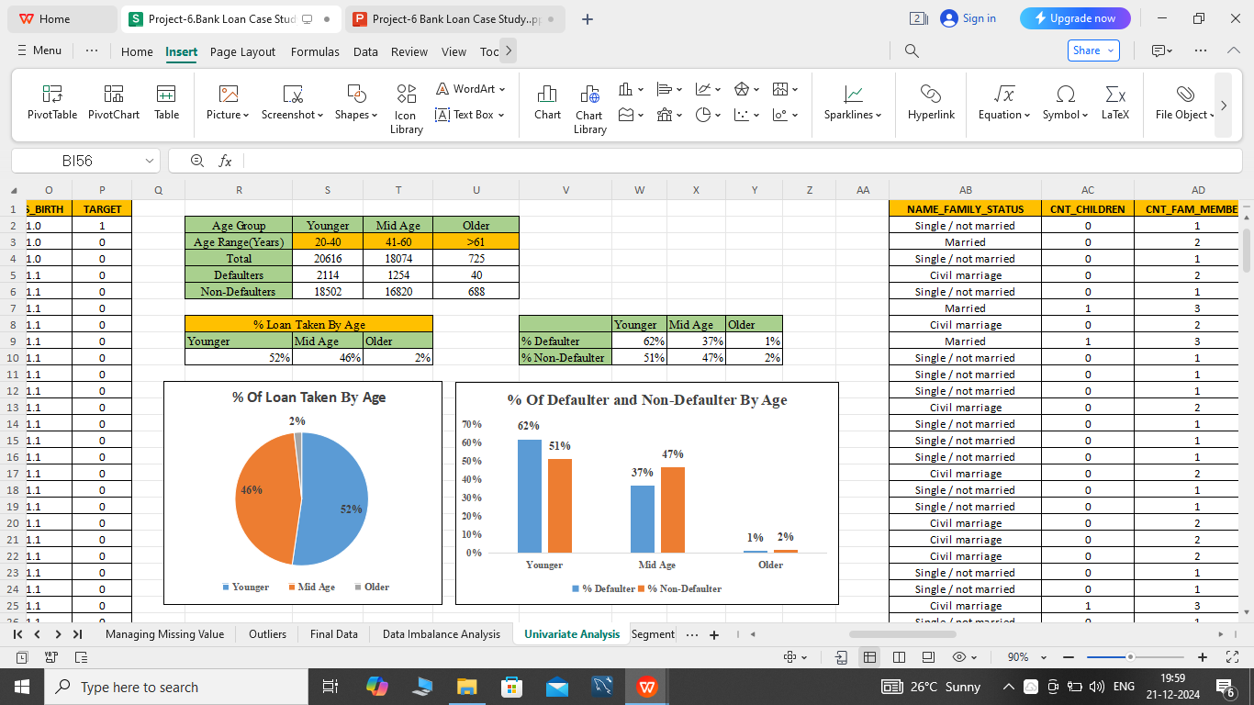
2) Age Analysis:- *The macimum number of loan is taken by Younger people, followed by Mid Age then Older.
*Also the % of Defaulter is large in Younger people.
*There is very mininun % of lone taken Old people.

Slide 12
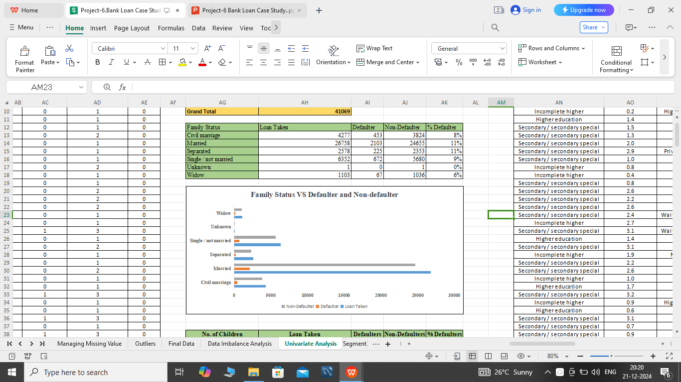
3) Family Status Analysis:- *The % Defaulter is more in the Married and Seperated peoples.
*The widows have very less % of Defaulter.

Slide 13
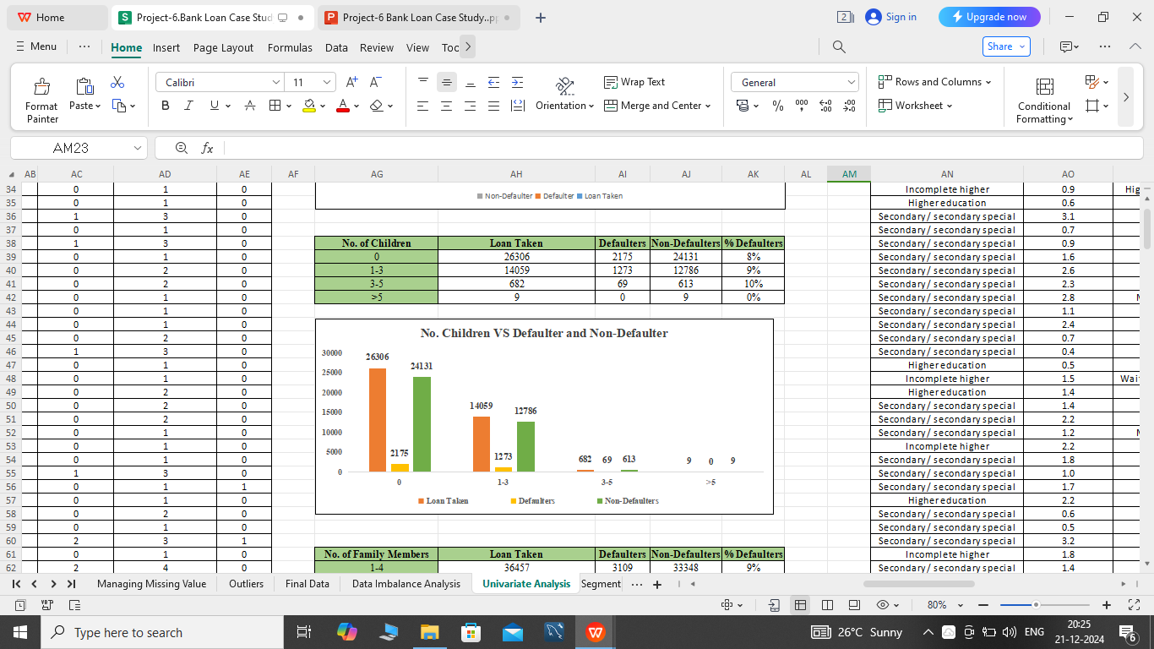
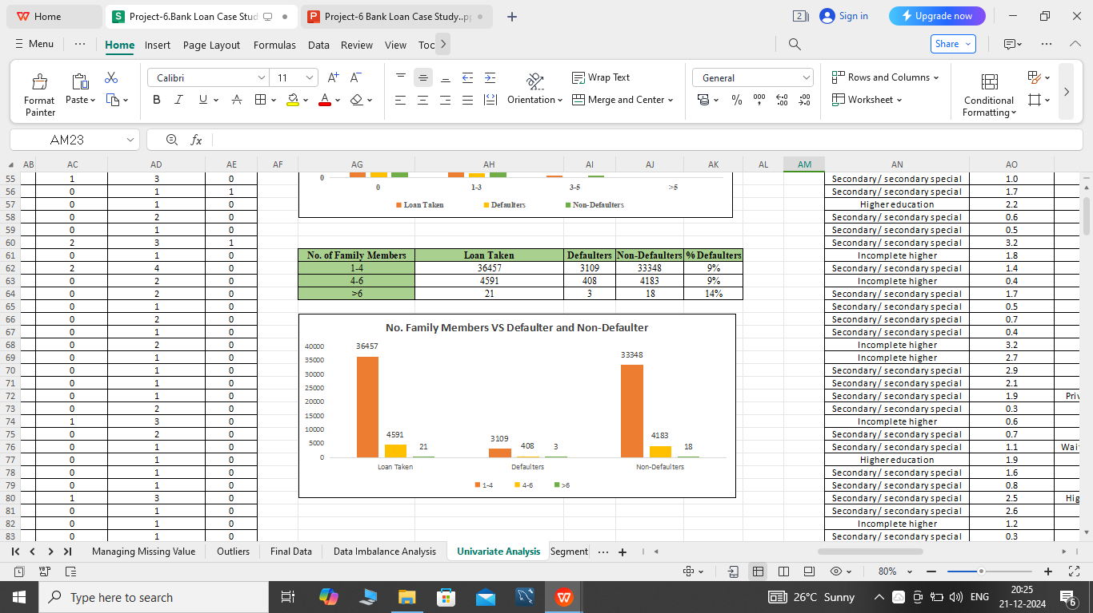
* The more number of people have taken lone who have no children and 1-3 childrens.
* The % of Defaulter is more who have 3-5 childrens.
*The number of lone taken by Small families are more also there % of Defaulter is less.

Slide 14
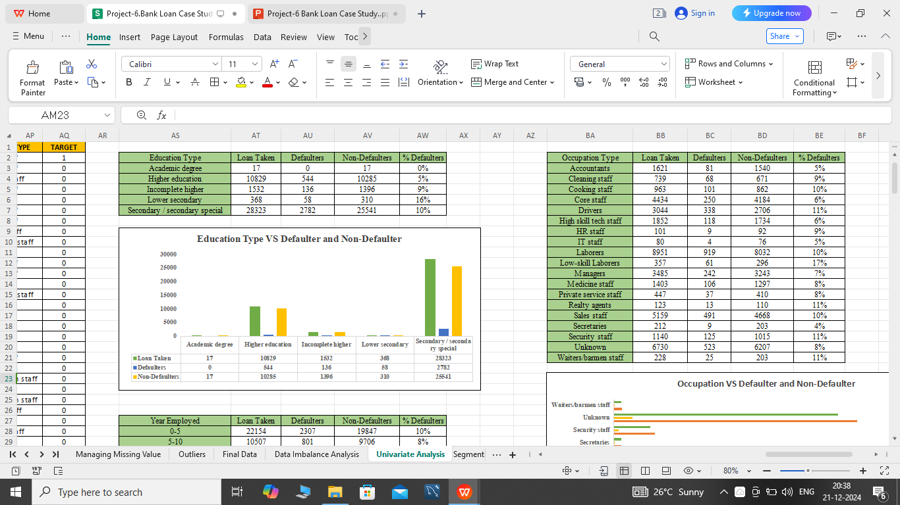
4) Education Analysis:- * There are large number of people taken lone whoes education is Secondary/Secondary Special education.
*The people with Lower Secondary education have more % of Defaulters.

Slide 15
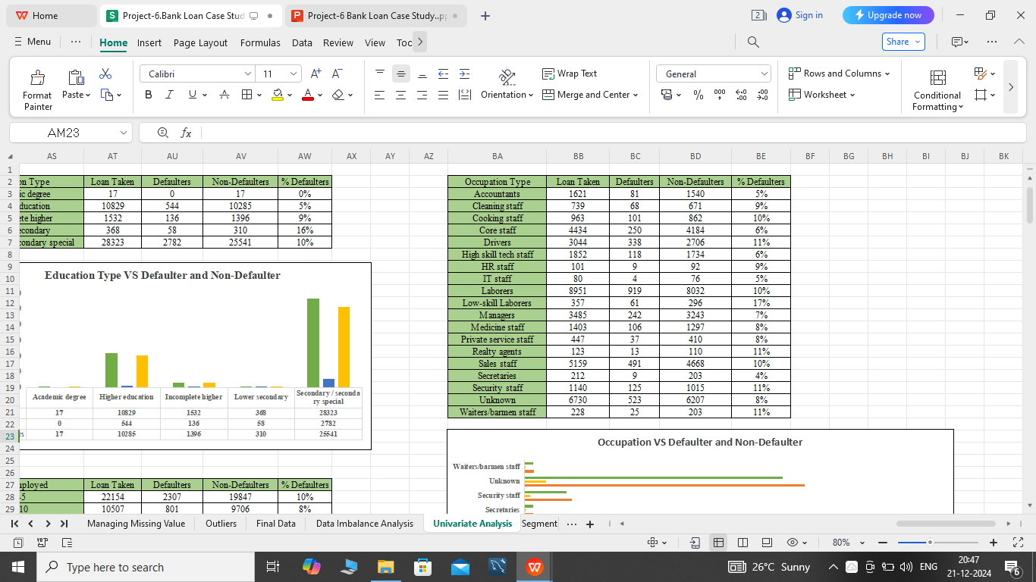
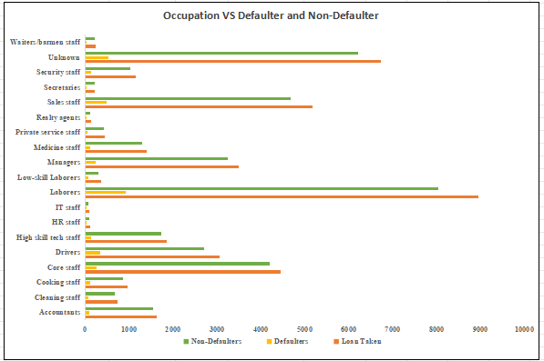
5) Occupation Analysis:- *The maximum number of customers are Laborers.
*The % of Defaulters are maximun in Low-skilled Laborers.

Slide 16
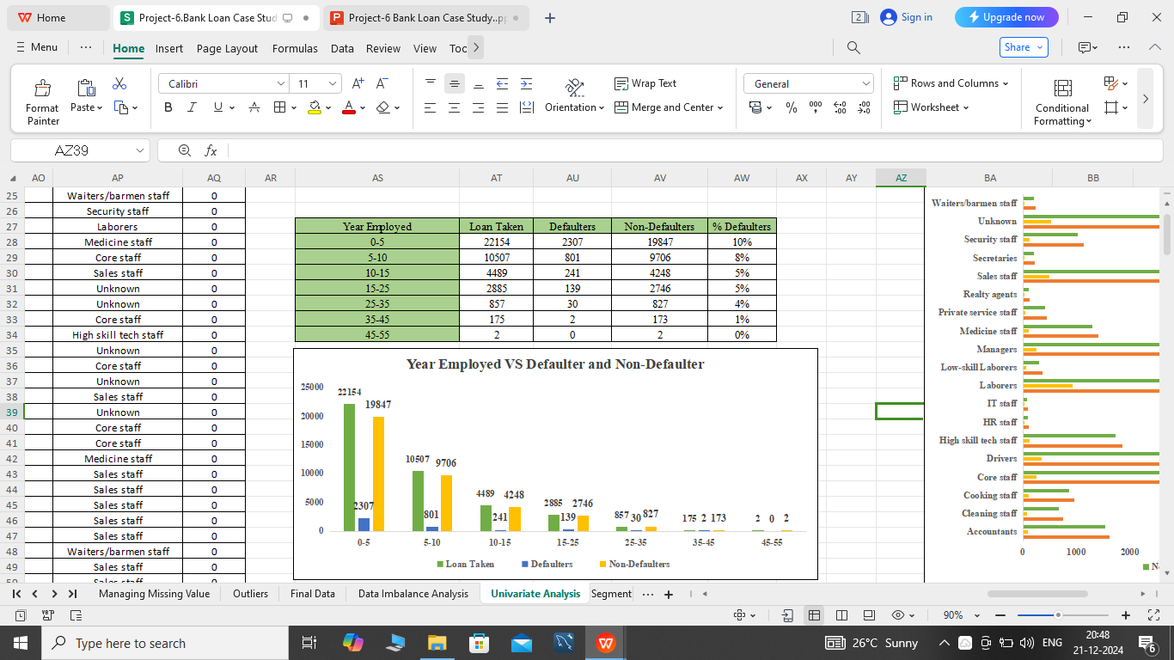
* There are more number of people with 5 or less then 5 years of experiance and they have maximun % of Defaulters,

Slide 17
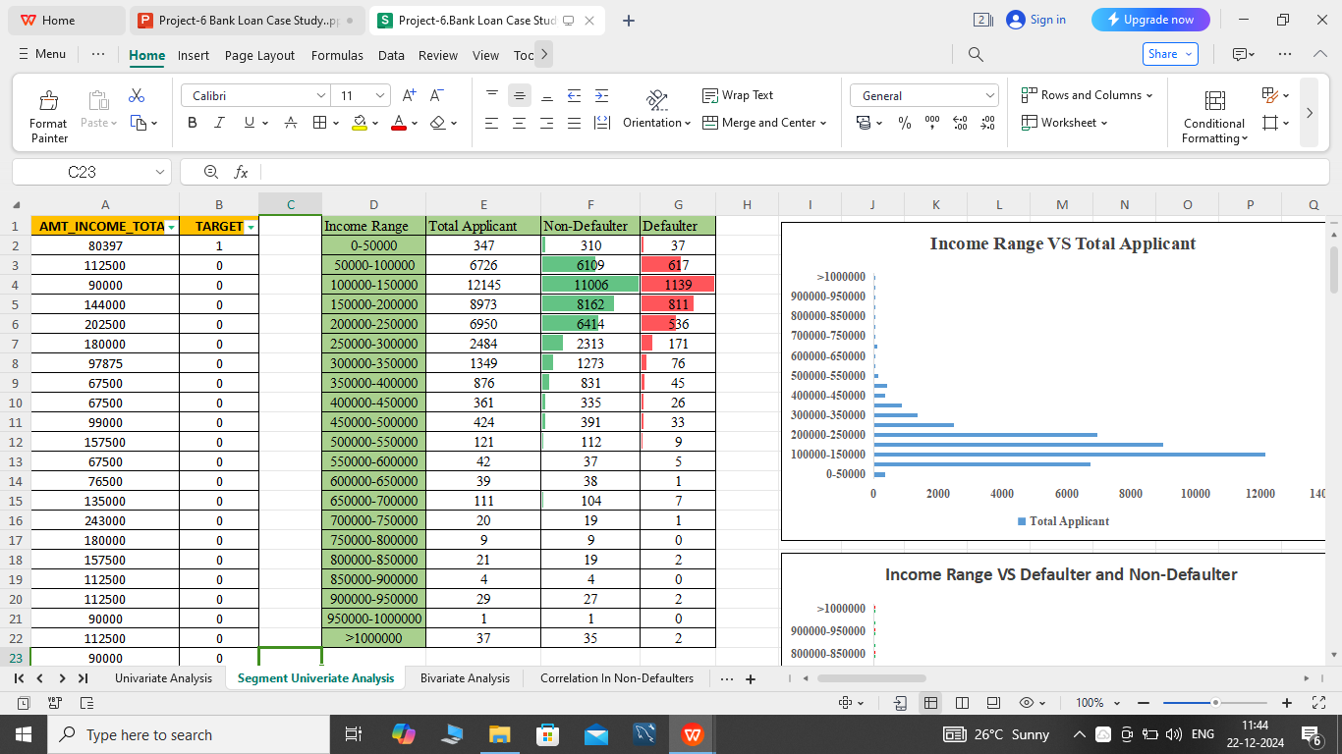
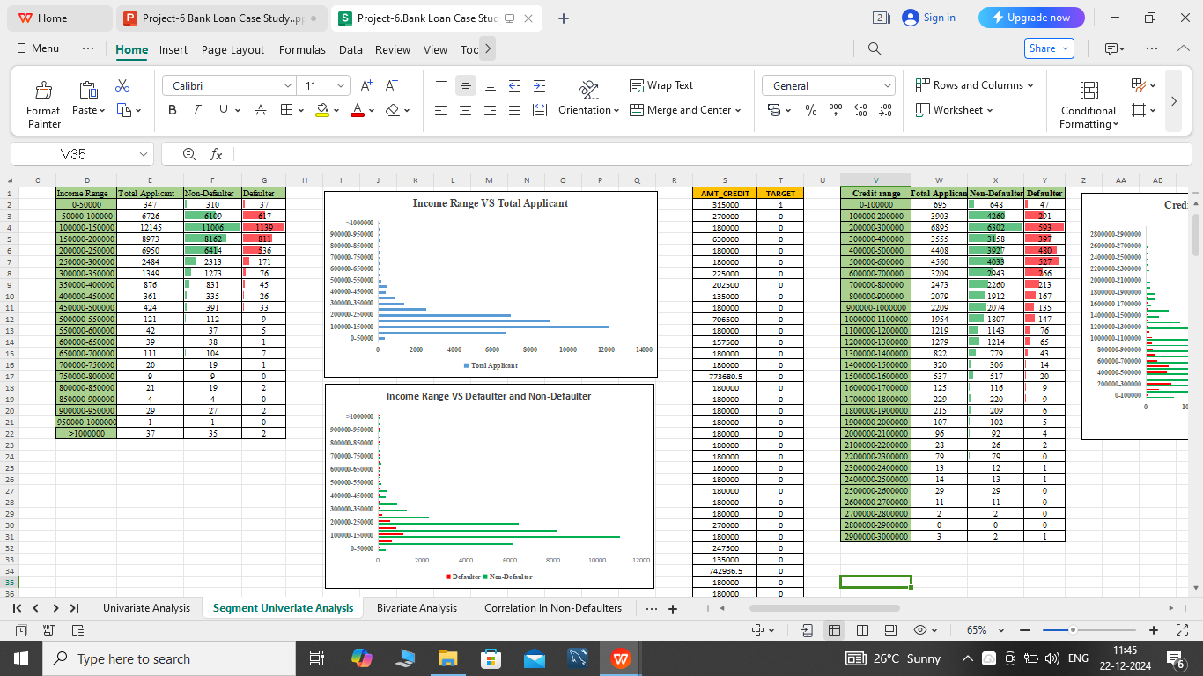
Segmented Univariate Analysis:- 1) Income Range:- *The most number of customer have Income between 50000-250000. also the number of Defalters are more too.

Slide 18
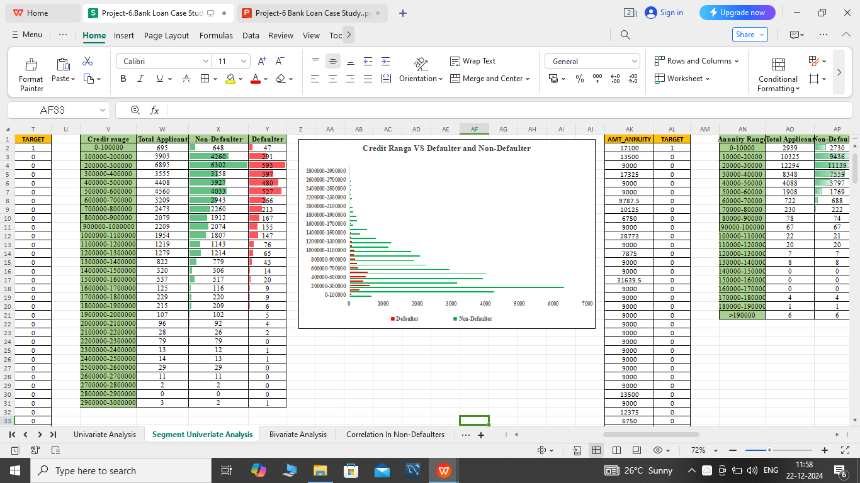
2) Credit Range:- * Most of the customers have Credit range between 200000-300000 also they have less number of Defaulters.

Slide 19
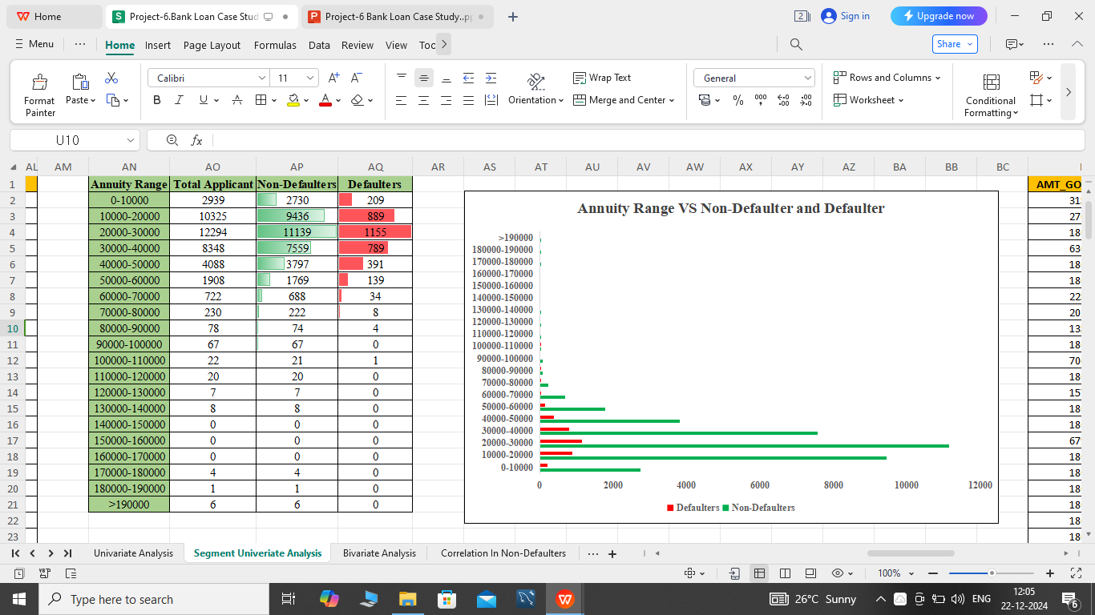
3) Annuity Range:- * The most of the peoples have Annuity range between 10000-40000 also they have approximately 10% - 15% of Defaulters.

Slide 20
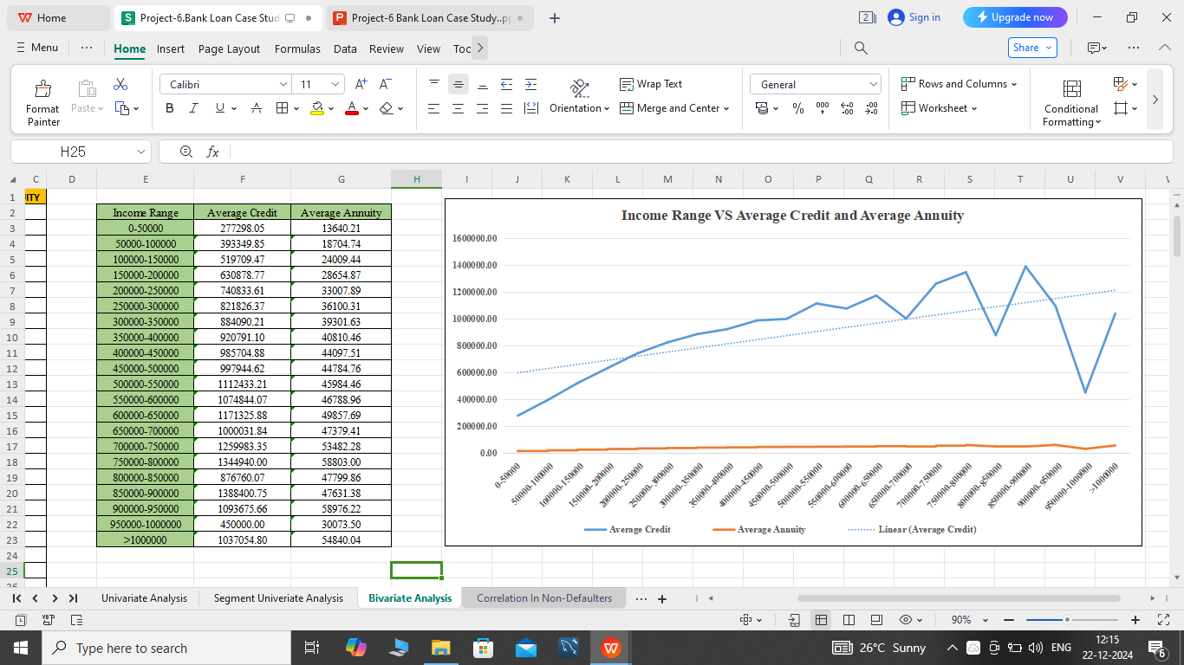
Bivariate Analysis:- *The Trendline shows that, if the Income Range is increased then the Average Credit also increaseed .The average annuity is also gradually increasing.

Slide 21
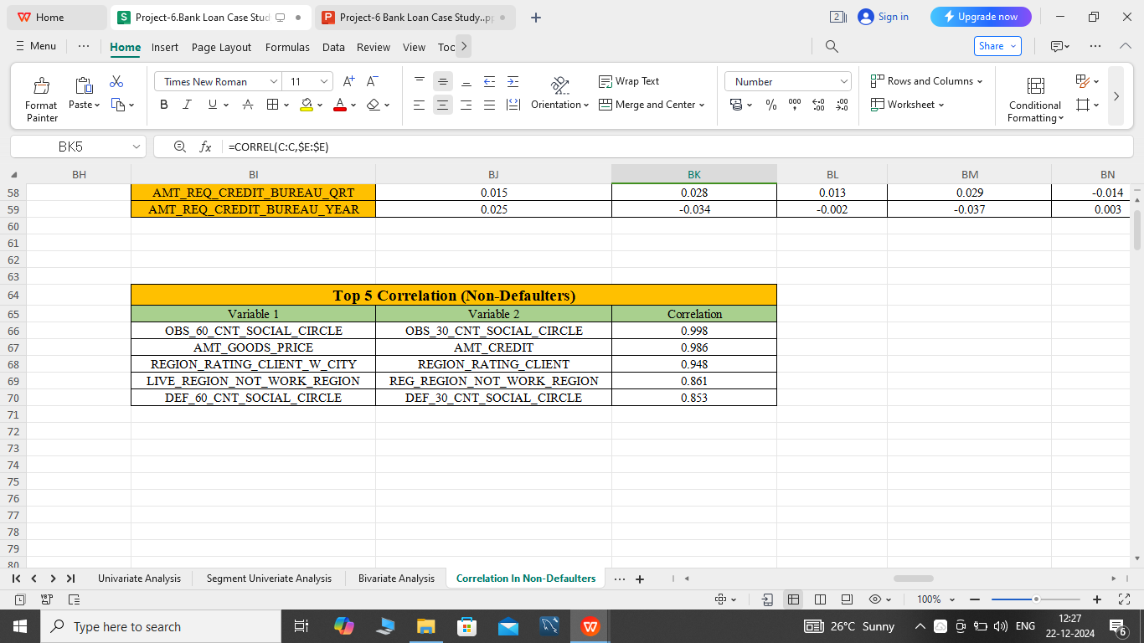

E) Identify Top Correlations for Differenr Scenarios:- Understanding the correlation between variables and the target variable can provide insights into stromg indicators ofloan default.
Task:- Segment the dataset based on different Scenarious. and identify the top correlations for each segmented data using Excel Functions.

Slide 22
END
MICROSOFT EXCEL FILE:- https://docs.google.com/spreadsheets/d/1tgmGcpx9cmGHbVpD6r4QAubecG-PgD_q/edit?usp=drive_link&ouid=103974361659264463652&rtpof=true&sd=true
VIDEO LINK:-https://www.loom.com/share/71722adfb0424bb59daa57fcc3e03340?sid=0dbcd61a-5f08-4723-b32b-2e9e41d52d1a

